Slide 1
Indian Waters Phase 1 Septic to Sewer Conversion Project
Informational Public Meeting
March 30th, 2021

Slide 2
Presentation Overview
Project Intent and Benefit
Preliminary Engineering Efforts
Project Funding
Project Timeline
Three Sisters Spring

Slide 3
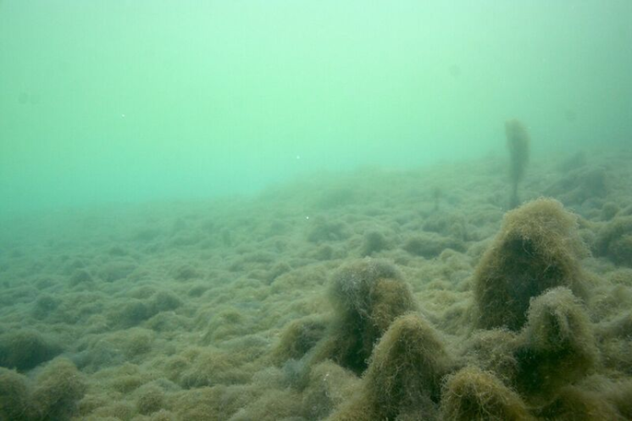
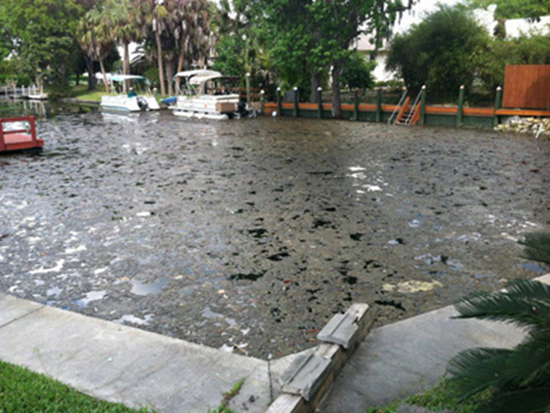
Crystal River / Kings Bay’s Septic Tank by the Numbers
Approximately 28,000 Septic Tanks in the Springshed.
250,000 lbs of Nitrogen / Year
42% of the Nitrogen Pollutant Load to the Springs
Kings Bay Algae Bloom
Hunters Springs Algae Mat

Slide 4
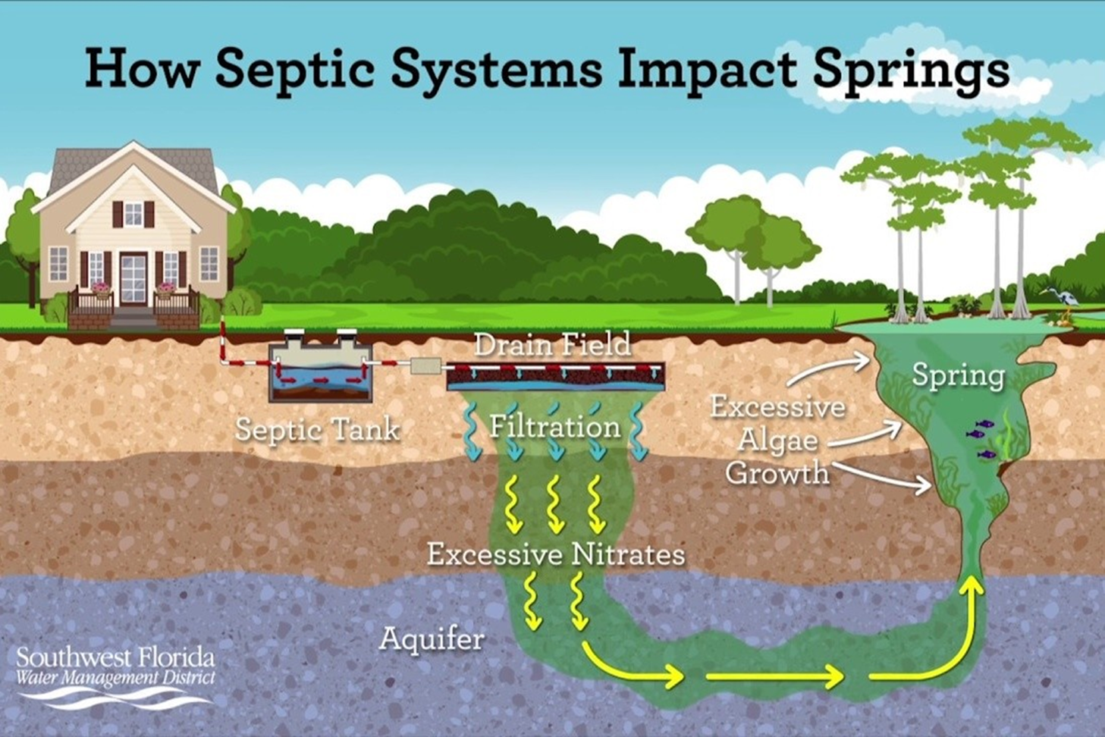

Slide 5
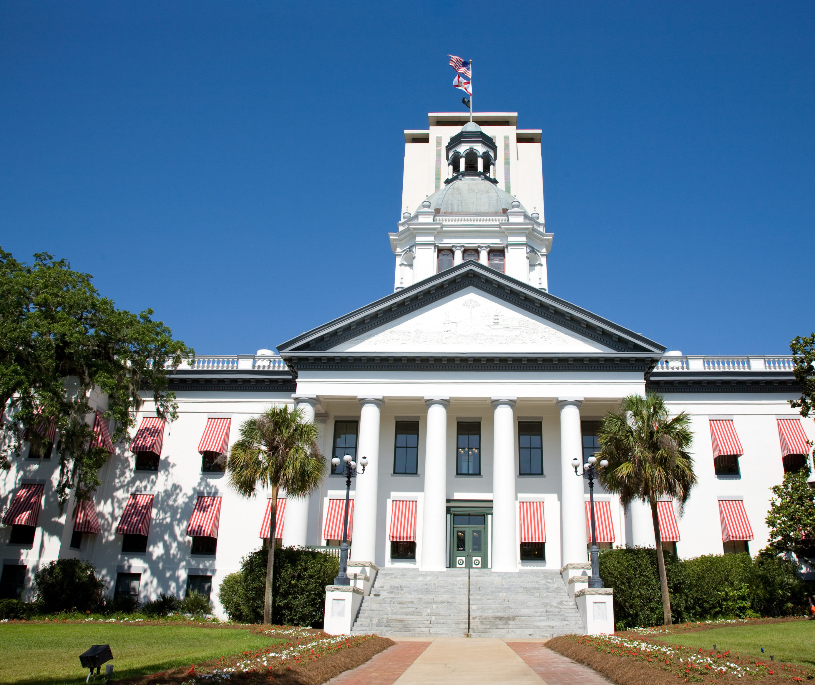
Florida’s Water Quality Regulatory Response
Florida Springs Protection Act
Made into law in 2016
Crystal River / Kings Bay Basin Management Action Plan (BMAP)
Adopted by FDEP in 2018
Florida Clean Waterway Act
Made into law in 2020

Slide 6
Regulatory Requirements
Establish the Total Maximum Daily Load (TMDL) for the Impaired Spring
Require BMAP Development
Set Priority Focus Areas (PFA) for all Springs
Identify Pollutant Sources
Identify Projects to Reduce Pollutants below the established TMDL Levels
Updated Every 5 Years
No conventional septic systems allowed on lots less than 1 acre and in the PFA

Slide 7
Regulatory Requirements cont
2023
After 2023 no traditional septic tanks will be allowed in the BMAP area regardless of the lot size and no permits on existing traditional septic tanks will be issued
2038
Enhanced septic sewer systems will be required throughout the entire BMAP on all lot sizes by 2038.

Slide 8
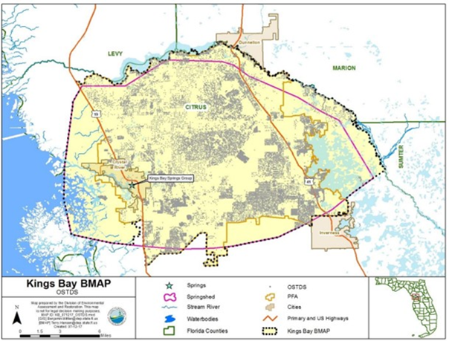
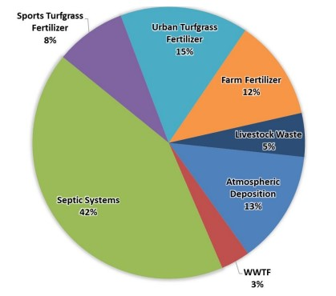
Crystal River / Kings Bay BMAP

Slide 9
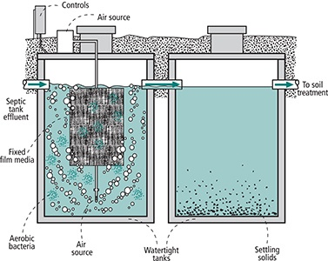
Enhanced Septic Systems
The Do-Nothing Option
Two Main Types
Passive Systems
Active Systems
Involve additional tanks, pumps, aeration, and/or biologically activated media
Active Systems cost between $20,000 - $30,000
Passive Systems cost between $13,000 - $17,000
Annual Maintenance and Inspection Required
Example Enhanced Septic System

Slide 10
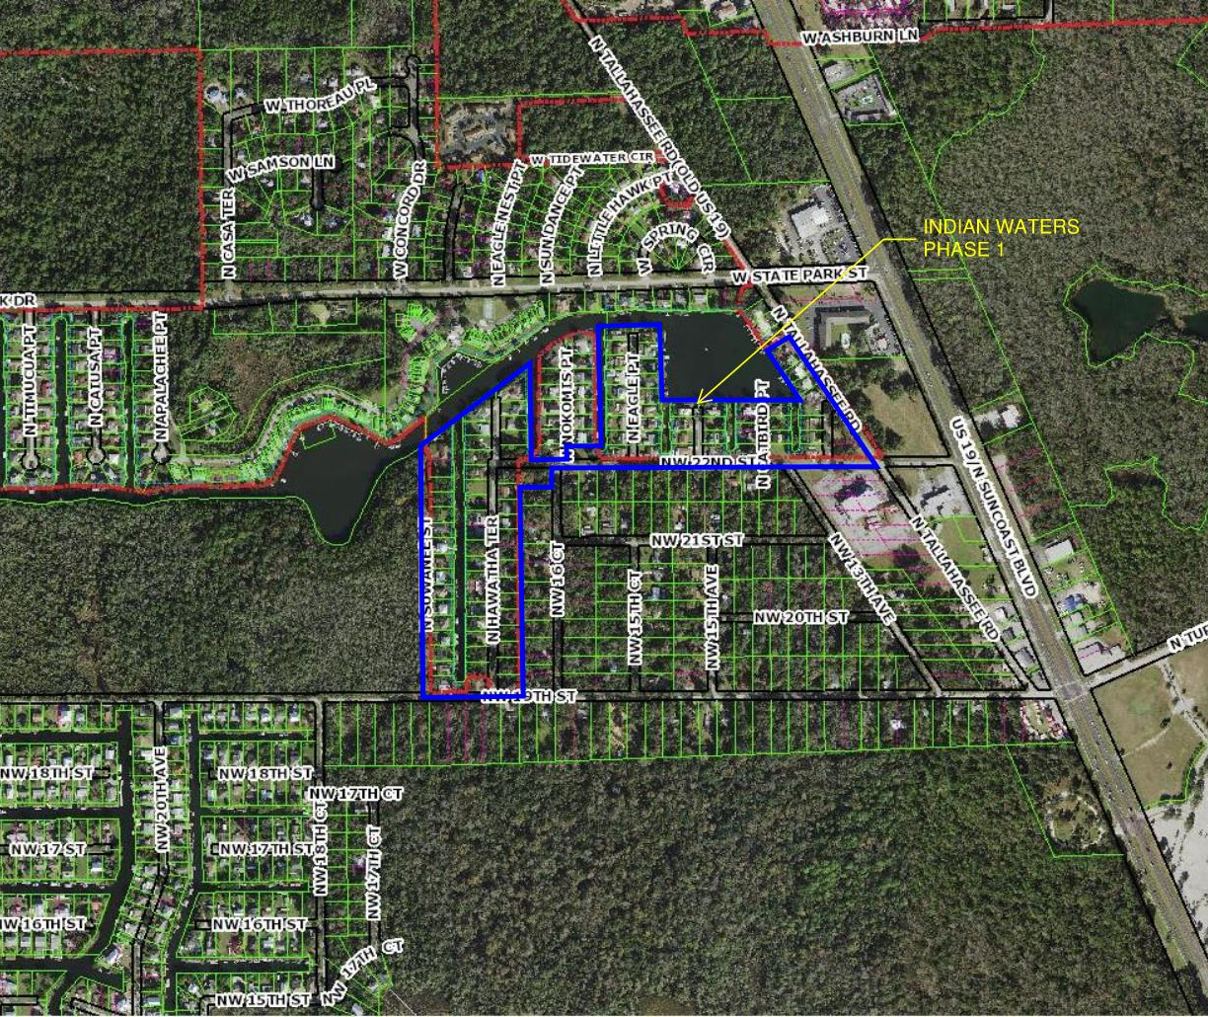
Indian Waters Phase I Project Benefits
Removal of approximately 86 septic tanks
510 lbs of Nitrogen per year
Avoid the regulations and costs for implementing enhanced septic tanks systems

Slide 11
Indian Waters Phase I Project Progress
Geotechnical Investigation
Soil Boring

Slide 12
Indian Waters Phase I Project Progress
Environmental Investigation

Slide 13
Indian Waters Phase I Project Progress
Preliminary Sewer Layout

Slide 14
Indian Waters Phase I Project Funding
Preliminary Project Cost Estimate
$1.5 - $1.7 Million in Construction Costs
$900,000 in Existing Grant Funding.
Springs Restoration Fund
Additional Sources for Funding.
319 Grant Funding
Property Assessment to cover what the grants do not
$ 10,000 - $11,000 per lot for Septic Tank Abandonment and Connection Fee
Covers 60% of the Septic Tank Abandonment and Connection Fee
Total Cost = $2.4 - $2.65 Million

Slide 15
Development of Wastewater Assessment Program
Determine Benefitted Properties – May–June
Develop Apportionment Methodology – May–June
Fair and reasonable way to spread the costs among benefitted properties
Create Assessment Database based on Benefitted Properties – May--June
Determine Assessment Revenue Requirements – May--June
Calculate Assessment Rates – June–July
Prepay Amount in Full
Pay over 10-20 year period through a non-ad valorem wastewater assessment

Slide 16
Implementation of Wastewater Assessment Program
Adopt Procedural Ordinance -- June
Adopt Initial Assessment Resolution -- July
Publish Notice of Public Hearing
Mail First Class Notices – August
Every property owner will get a notice in the mail
Explaining the wastewater assessment program
Costs to the property owner
Inviting to public hearing
Public Hearing to Adopt Final Assessment Rates – September
Construction Starts - September
Prepayment Notices Mailed - September
Prepayment Period – September through October
Wastewater Assessment Collected on Tax Bill -- November

Slide 17
NEXT PUBLIC MEETING WILL BE JUNE 22, 2021

Slide 18
QUESTIONS & DISCUSSION

